Slide 1
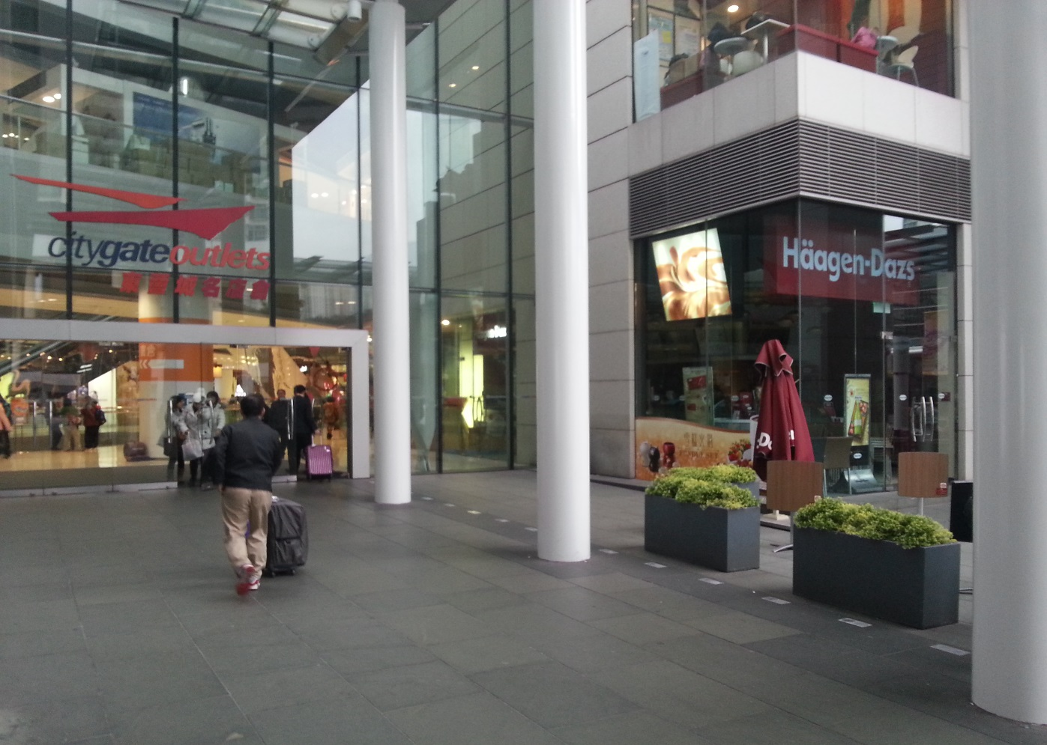
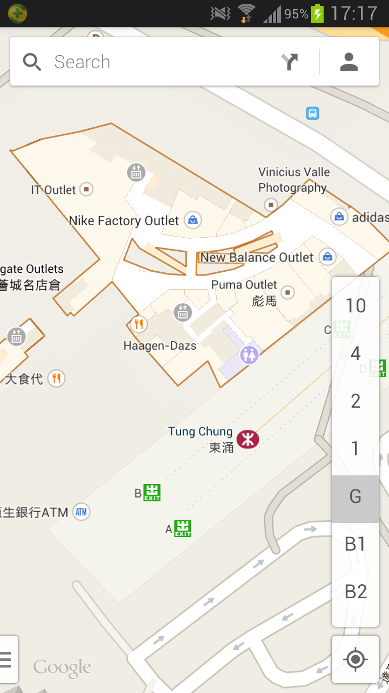
Citygate Outlet adjacent to Haagen-Dazs
CASL Visit
Meeting Point
8-March-2014 0900hrs
HAECO Visit
Meeting Point

